Slide 1

Analytics
Rachel Wang, Thai Wichienwidhtaya, Aaron He
Group 5
I S 451

Slide 2
Any YouTubers?

Slide 3
Agenda
01
02
03
04
05
Overview
Methodology
Results
Discussion
Conclusion
Notes:
Presentation Outline:
Intro/Overview
Dataset description
Goals/Stakeholders
Data Cleaning
Methodology
Using with / without outliers
Correlation matrix
The models we used
Results
Describe model with best results
Linear Regression
Logistic Regression
What factors contribute most to revenues
Use an example to see how our data predicts Revenues
Mr. Beast example
Discussion
Explanation of 2022 being most successful
Recommendation to stakeholders, if any
Challenges with data & how we overcame them (could also move this to overview)
Conclusion
Data wishlist
What we would improve on in the future / Do differently

Slide 4
01
Overview

Slide 5


Stakeholders
YouTubers
YouTube
General Public

Slide 6
Goals
Build Models:
Predict Revenue of videos
Predict whether the revenue generated by the videos is larger or smaller than the median of revenue.
Analysis of Factors that Affect Revenue

Slide 7
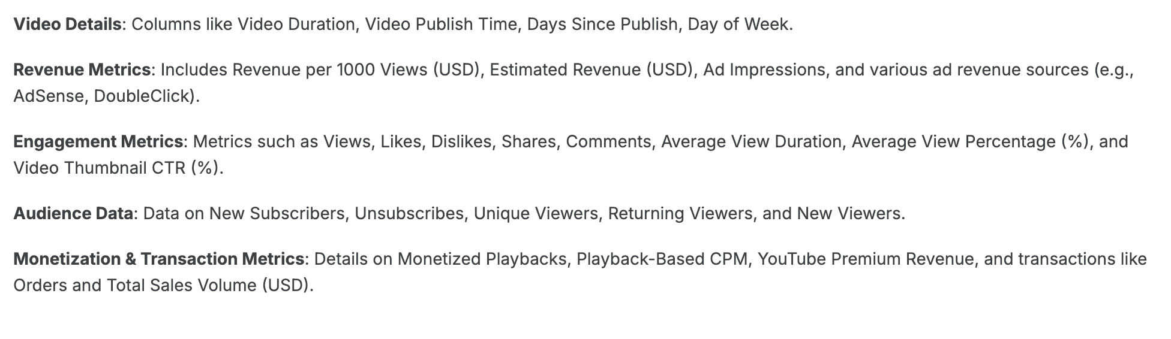
YouTube Analytics Dataset

Slide 8
Features
Independent variables:
'Day of Week',
'Video Publish Time',
'Views',
'Shares',
'Video Duration',
'Dislikes',
'Likes',
'Subscribers'
Dependent variable:
Estimated Revenue (USD, in 10,000s)

Slide 9
02
Methodology

Slide 10
Data Cleaning
Missing Values
Duplicate Values
Format
Anomaly

Slide 11
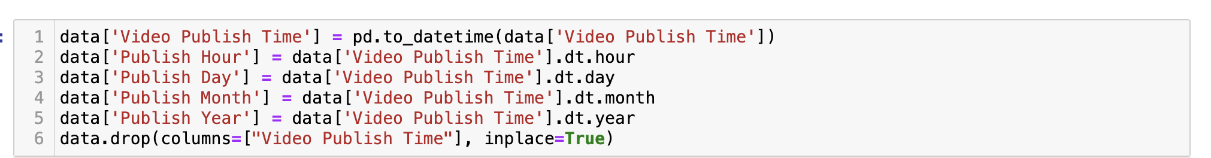
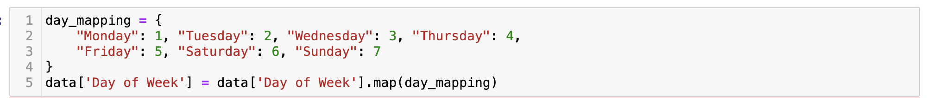
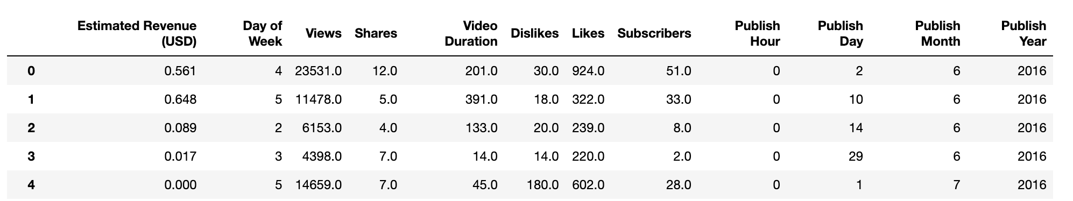
Format

Slide 12
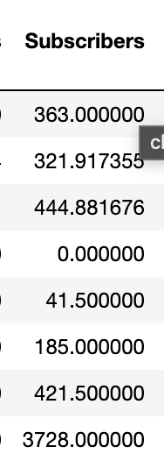
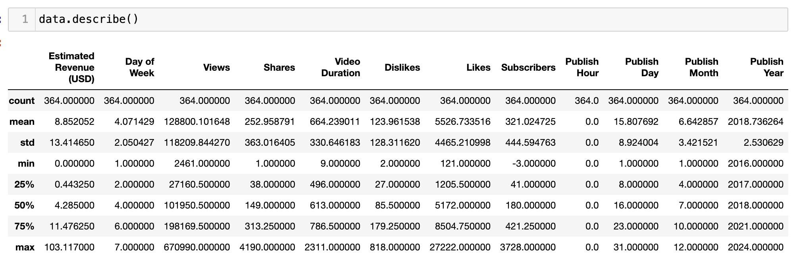
Anomaly

Slide 13
EDA
364 Rows (K-Fold Validation)
Distribution
Correlation Matrix
Scatterplot Analysis

Slide 14
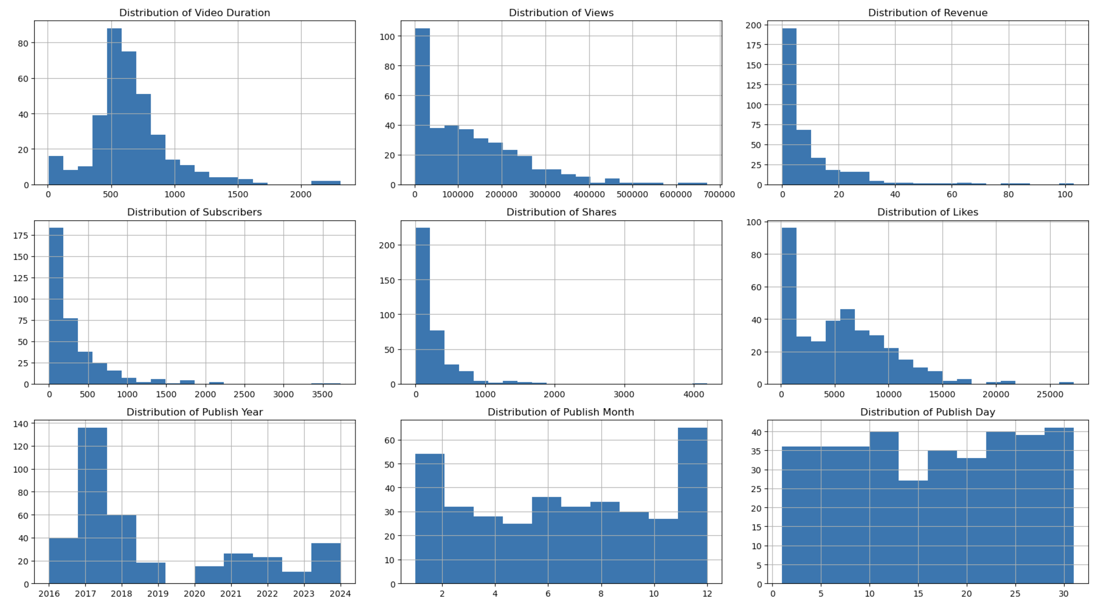

Slide 15
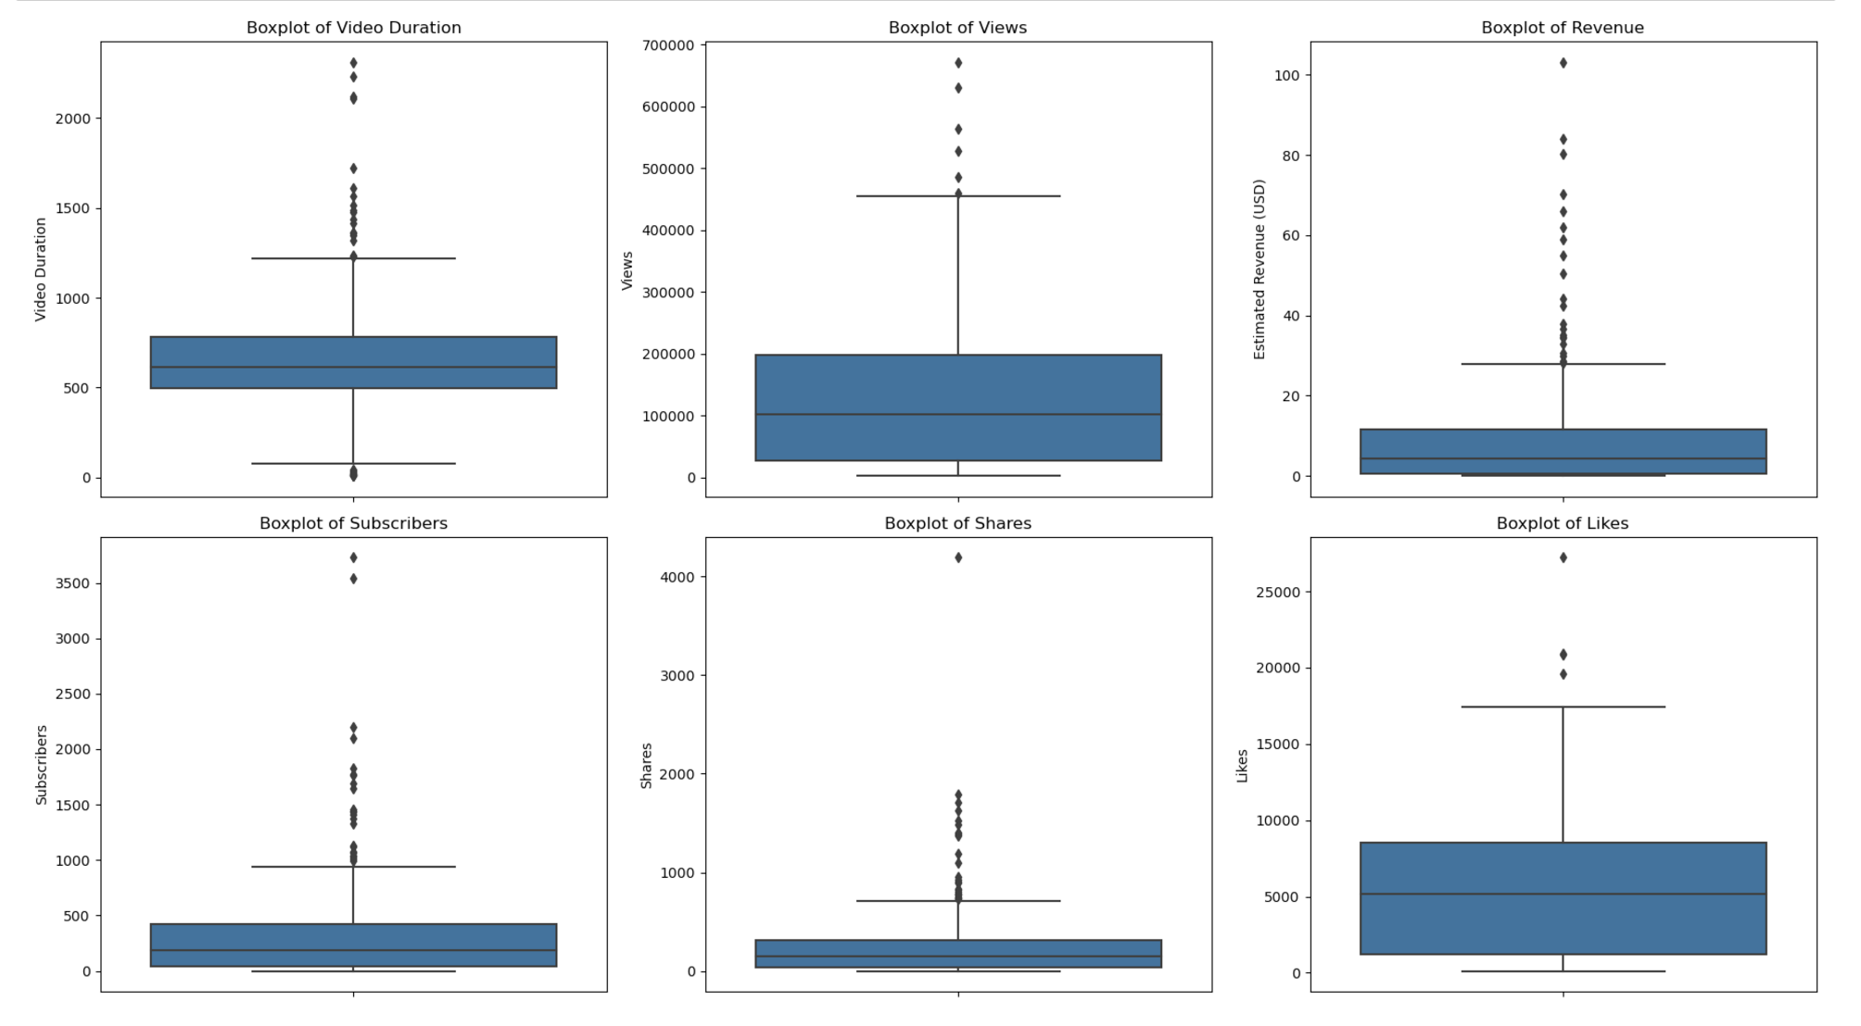

Slide 16
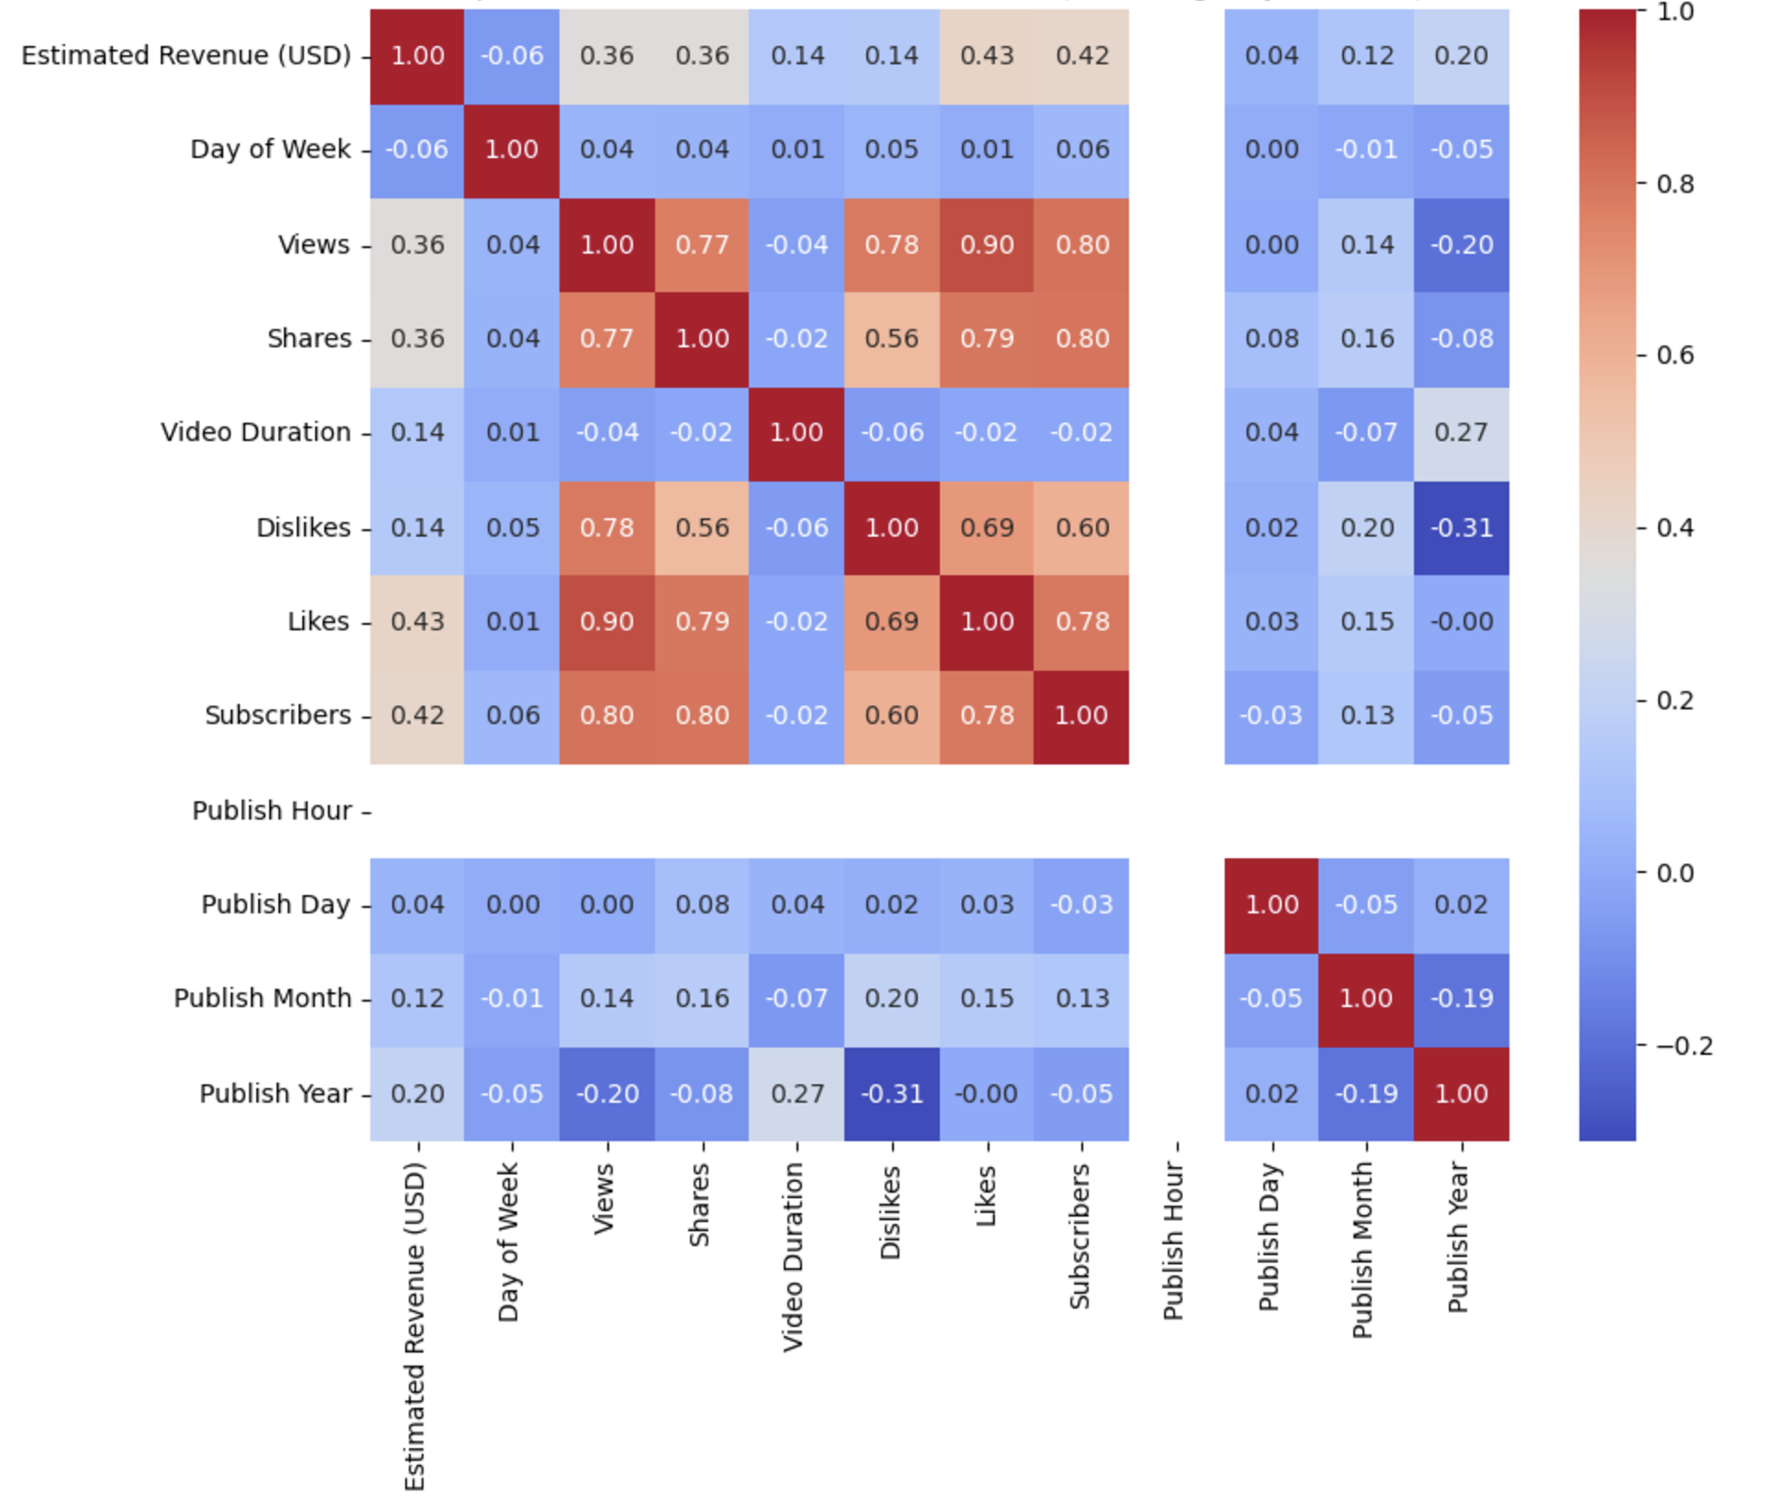

Slide 17
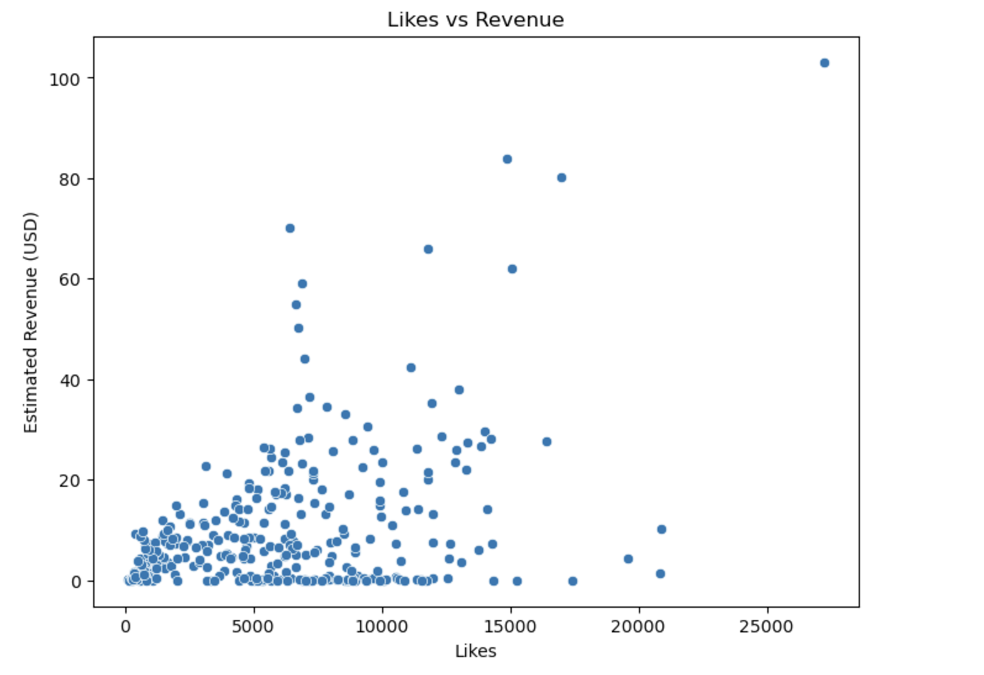
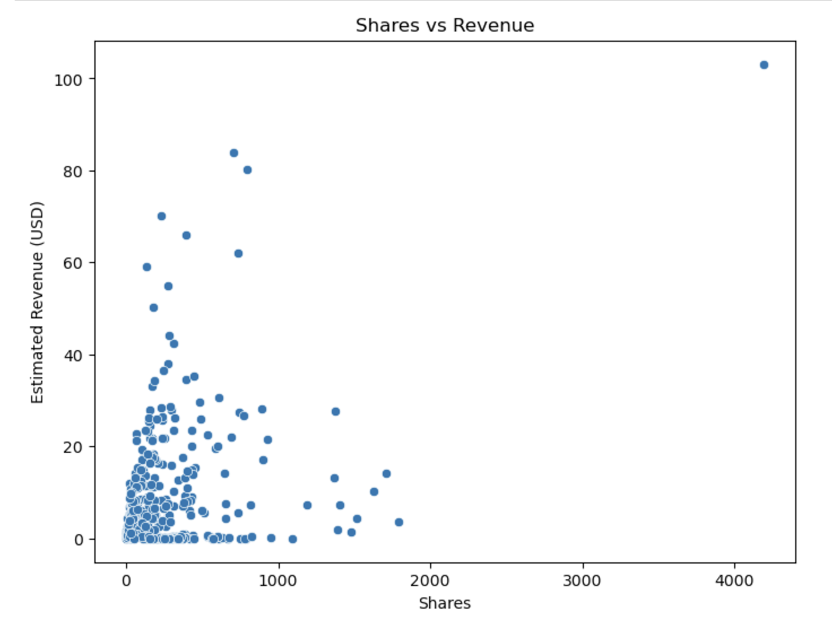
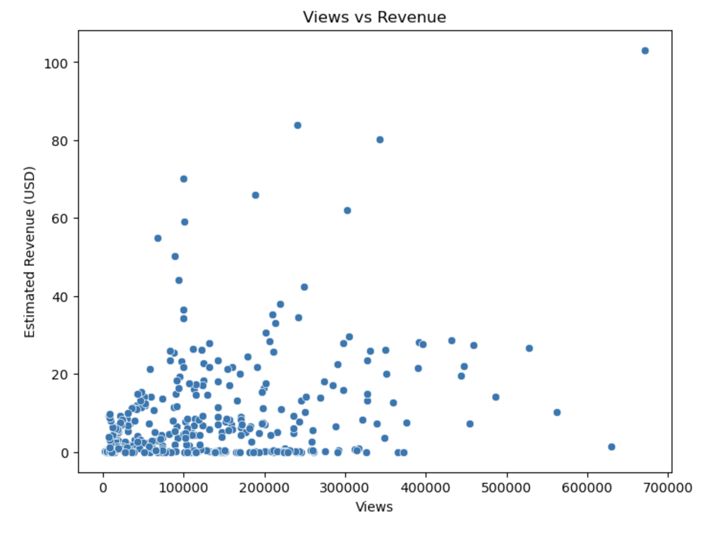
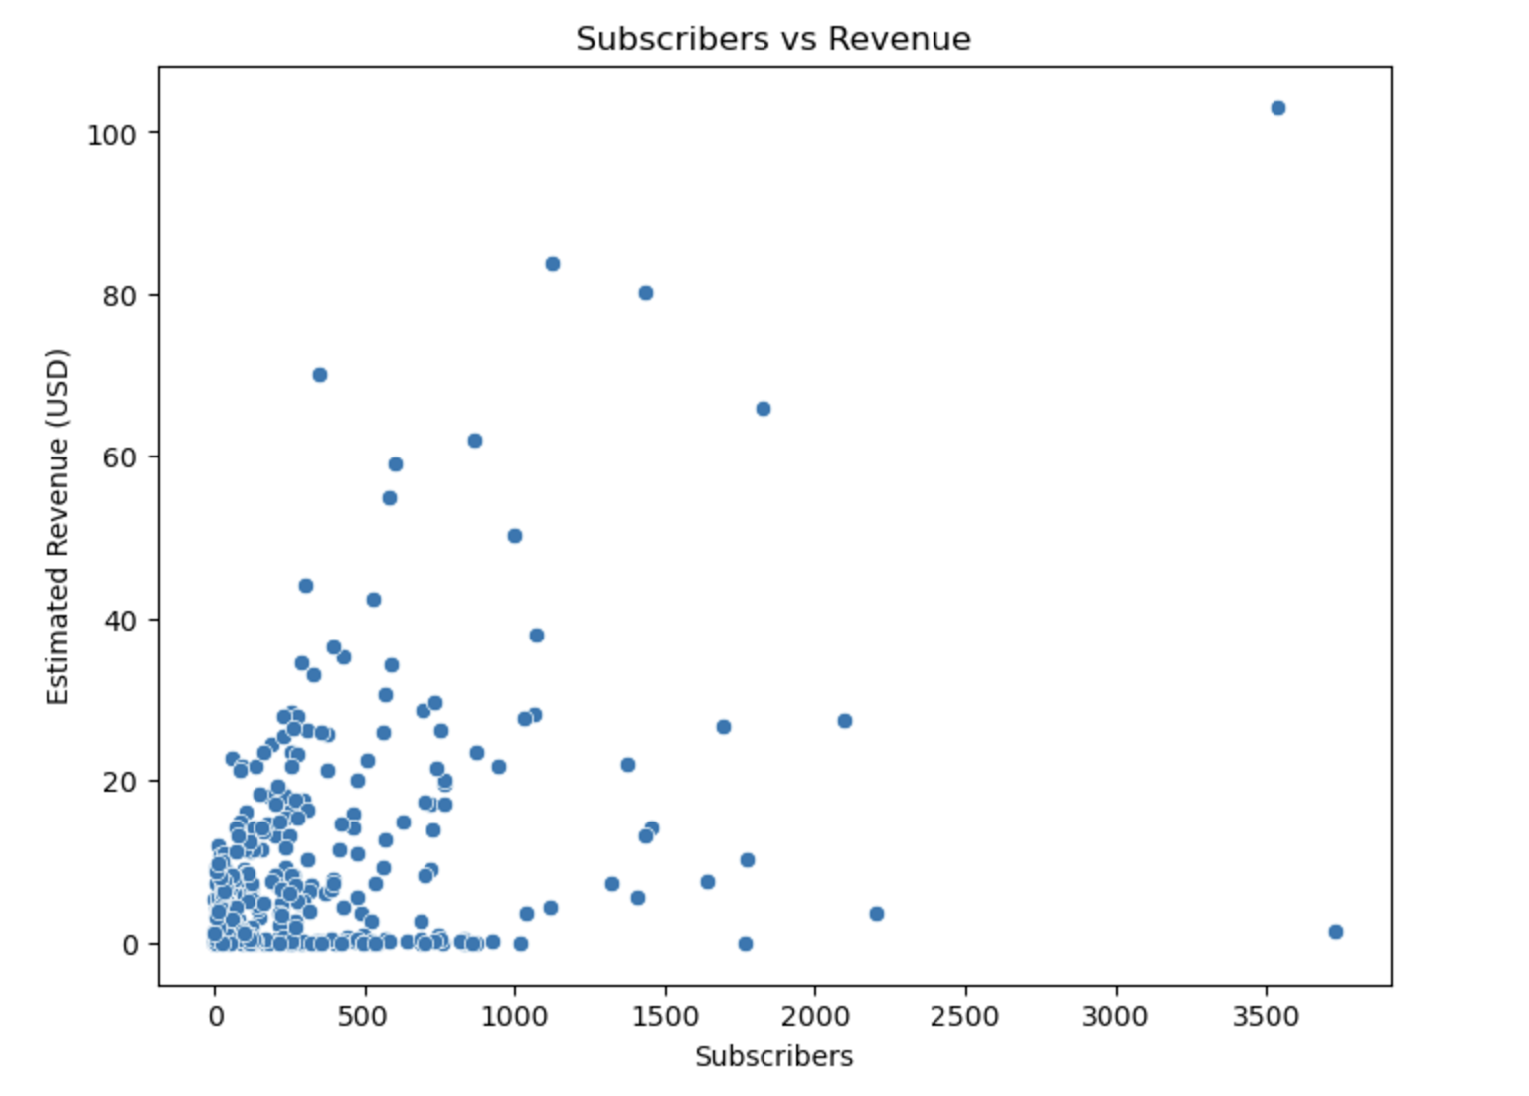

Slide 18
Models
Convert Categorical Variable
Normalization
Sample Weight
K-fold Cross Validation
With/without Outliers
Different Models with Different Parameters
Feature Importance Score

Slide 19
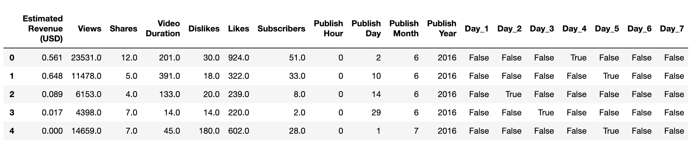
Convert Categorical Variable

Slide 20
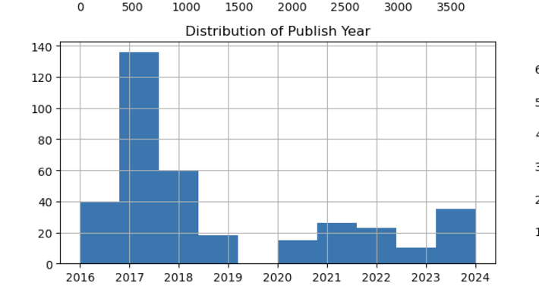
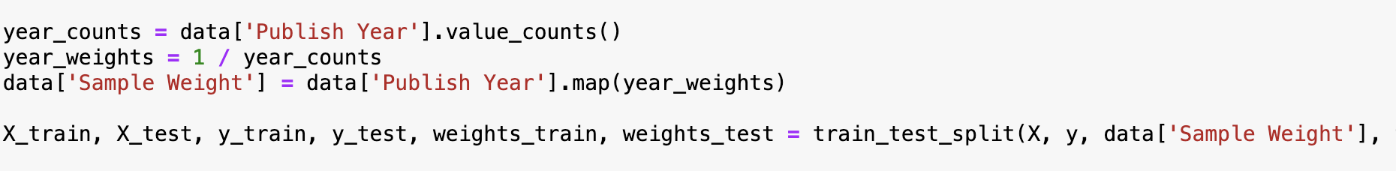
Sample Weight

Slide 21
Normalization

Slide 22
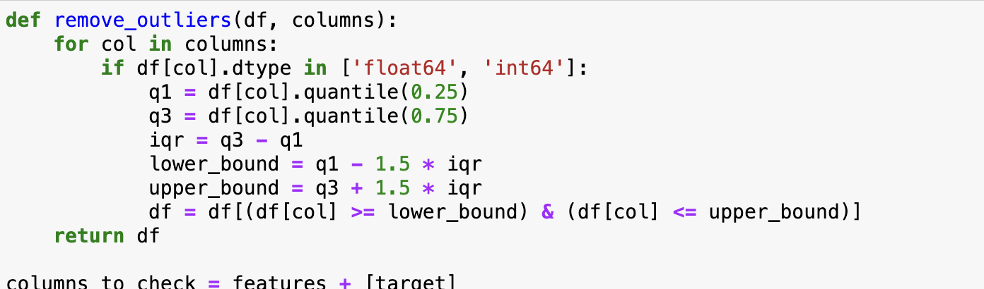
Remove Outliers

Slide 23
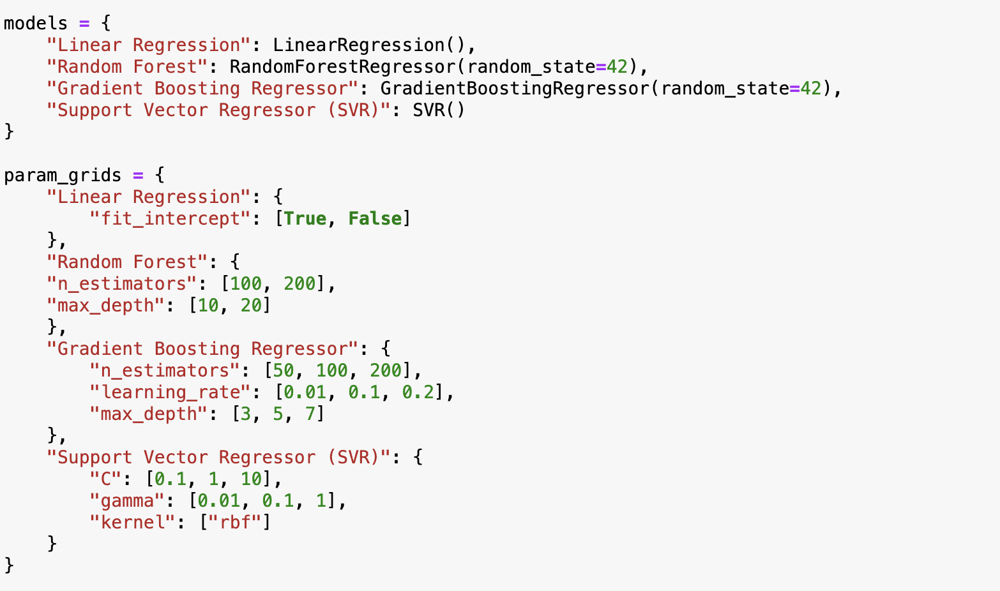
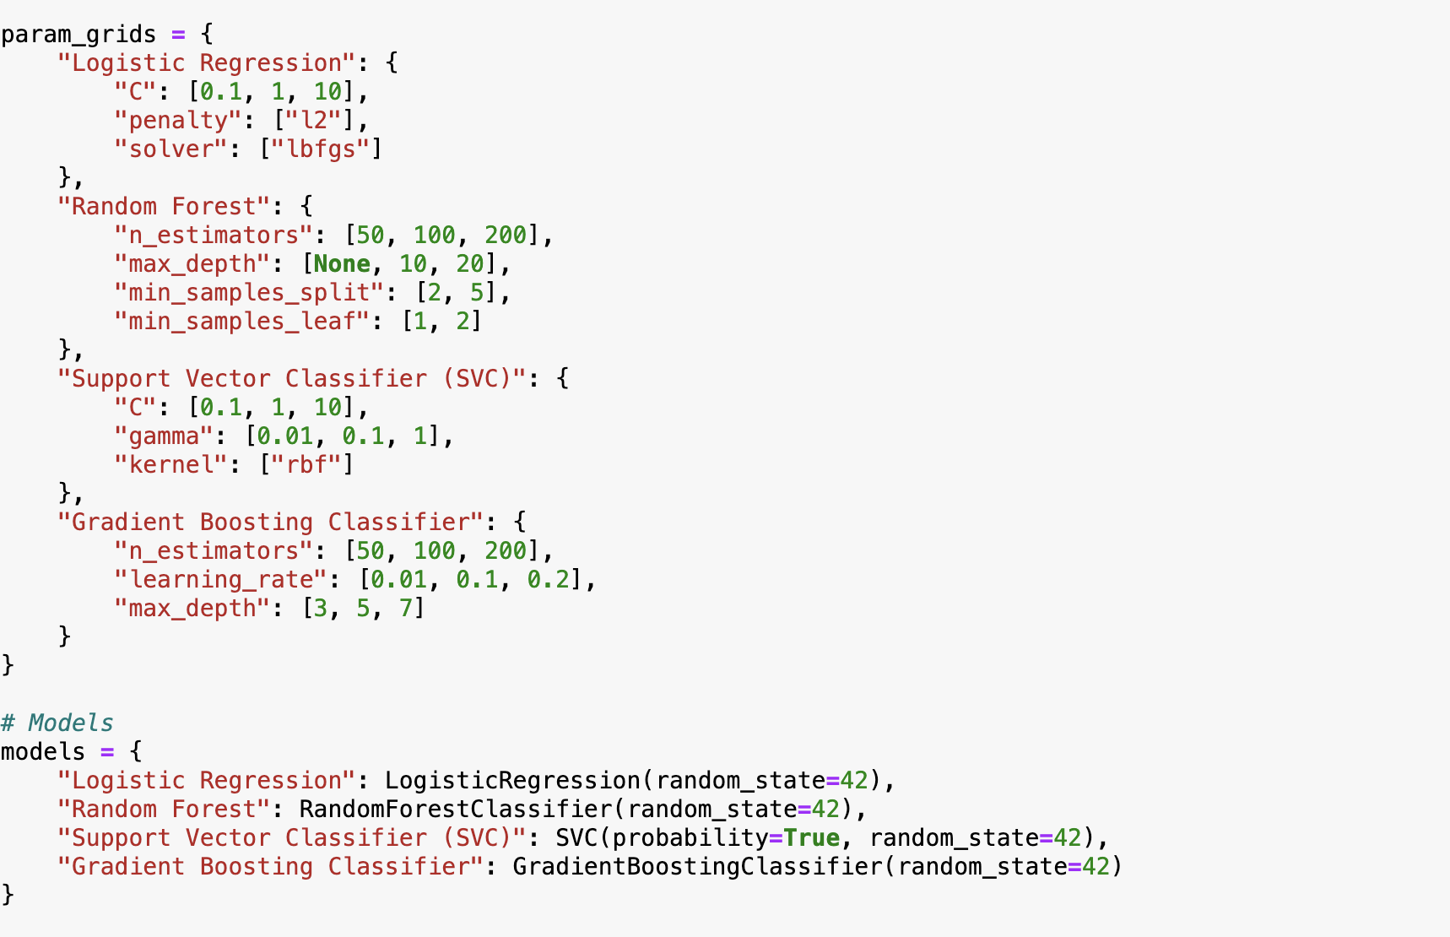
Different Models with Different Parameters

Slide 24
03
Results

Slide 25
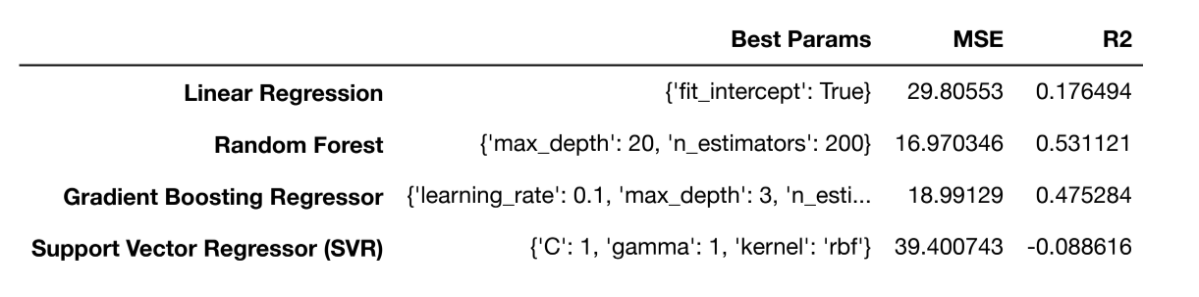
Linear Model
Random Forest and Gradient Boosting Regressor performed the best with the dataset:
Random Forest slightly stronger
Mean Squared Error (MSE) = 16.970346
R-Squared (R2) = 0.531121

Slide 26
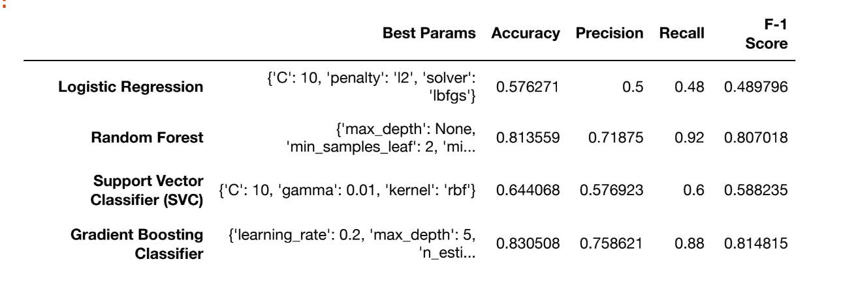
Binary Model
Random Forest and Gradient Boosting Regressor performed the best with the dataset:
Gradient Boosting Regressor slightly stronger
Accuracy = 83%
Precision = 76%
Recall = 88%
F-1 Score = 81%
Notes:
Gradient Boosting is a powerful machine learning algorithm used for both classification and regression tasks. It builds an ensemble of weak learners, typically decision trees, in a sequential manner to improve the model's performance by minimizing the loss function. Gradient Boosting works by training each new model to correct the errors made by the previous models.

Slide 27
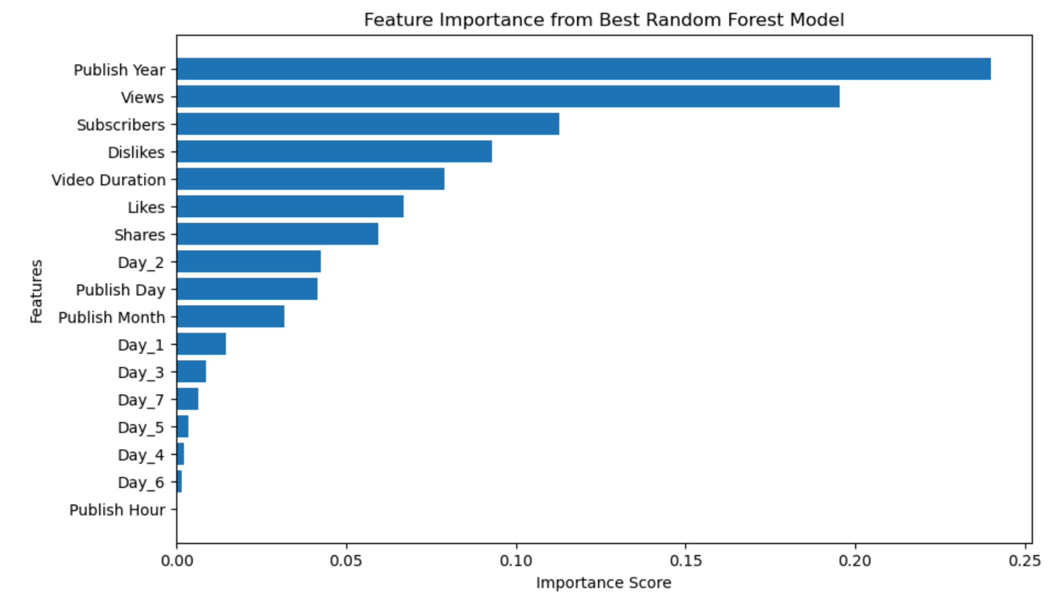
Linear Model Key Factors
Key:
Publish Year
Views
Subscribers
Dislikes (??)
Video Duration
Insignificant:
Publish Times Besides Year (Month, Day, Hour)
Publish Hour = Irrelevant

Slide 28
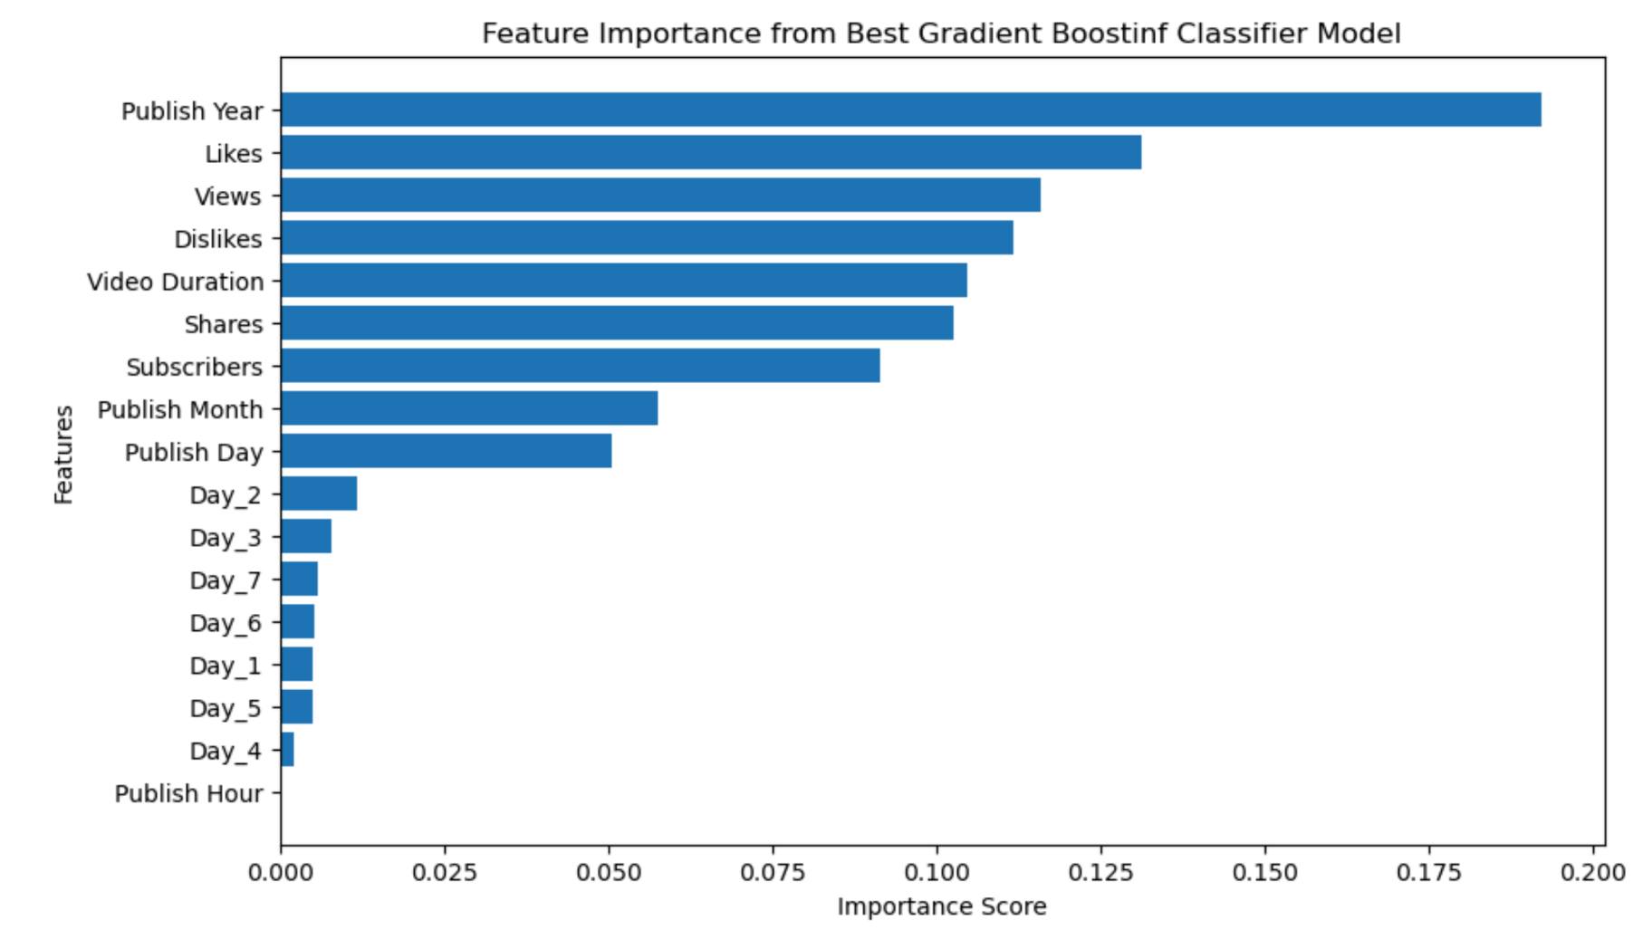
Binary Model Key Factors
Key:
Publish Year
Likes
Views
Dislikes
Video Duration
Insignificant:
Publish Times Besides Year (Month, Day, Hour)
Publish Hour = Irrelevant

Slide 29
Linear
Binary

Slide 30
Game Time!

Slide 31
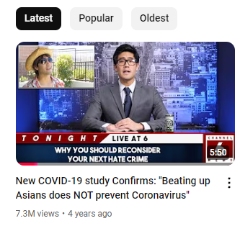
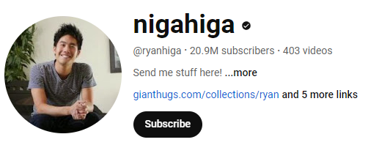
How Much Revenue Did Ryan Make?!
20.9M subscribers
7,395,615 views
Date: Apr 24, 2020
Duration: 350 Seconds
Dislikes: 5,195
Day: Friday (5)
514,549 likes
45,454 comments
Publish Time: 12:24:56 pm
Shares estimate: 25,727
Notes:
Web Calculator: $3,697-$147,913.46 (I could of made something up like that) as ad Revenue per 1,000 views (RPM) can differ greatly creator to creator. Ours does fall within the range that it provides, which was reassuring to see though.

Slide 32

$36,765.15!
Notes:
3.676515 * 10K = $36,765.15

Slide 33
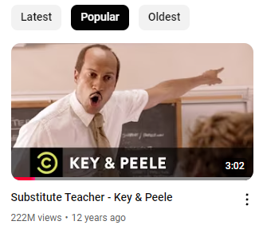
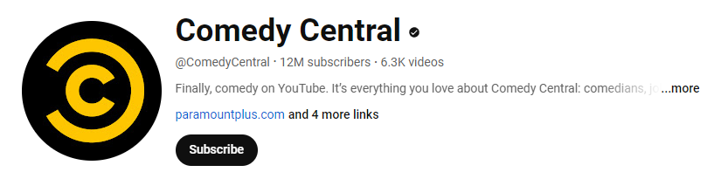
How Much Revenue Did K&P Make?!
12M subscribers
222,091,286 views
Date: Oct 17, 2012
Duration: 182 Seconds
Dislikes: 34,451
Day: Wednesday (3)
2,122,042 likes
68,640 comments
Publish Time: 20:52:15 pm
Shares estimate: 106,102
Notes:
Web Calculator: $111,045.64 - $4,441,825.72. Ours does fall within the range.

Slide 34
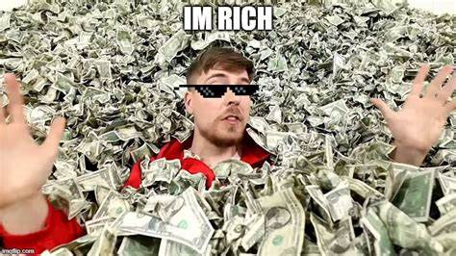
$165,822.75!
Notes:
3.676515 * 10K = $36,765.15

Slide 35
04
Discussion

Slide 36
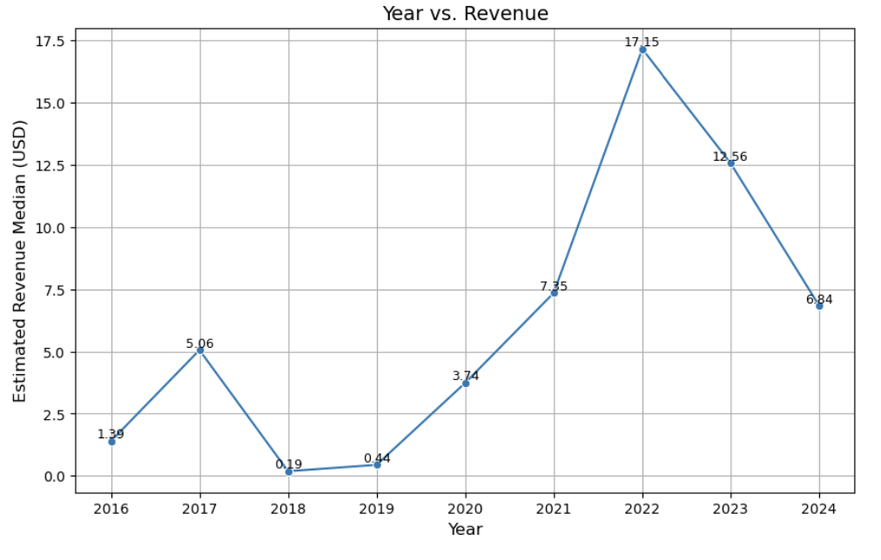
Revenue Spike in 2022?
Possible Reasons
Shorts Promotion
#2 Most Popular social media network
People watched 19 hours/week, compared to 18 in 2021 and 17 in 2023 (Statista).

Slide 37
Implications for Stakeholders
Content Creators
YouTube
Publish Year
What kind of audience do you want?
Targeted videos
Promote Shorts
Improvements on algorithms
Same goals as content creators
Likes
Views

Slide 38
Data Wishlist
Demographic Data
Video Descriptions
More Data Overall
Age group
Country
Gender
What type of video appeals to certain groups?
Search keywords
Which videos garner most revenues?
Only have 364 data points
More points strengthen our model

Slide 39
Data Improvements
Negative Subscribers
Adjust for Inflation
Correct numbers instead of removing from dataset
Data points from 2016-2024
Retrain Model
Model with Outliers
Without Publish Day variable
Validate outlier points and rerun model

Slide 40
05
Conclusion

Slide 41
Conclusion
Binary model fit our data better than linear model
Publish Year, Likes, Views were most indicative of whether revenues would be above or below the median.
More data records would strengthen the model

Slide 42
THANKS!
Questions?

Slide 43
Appendix

Slide 44
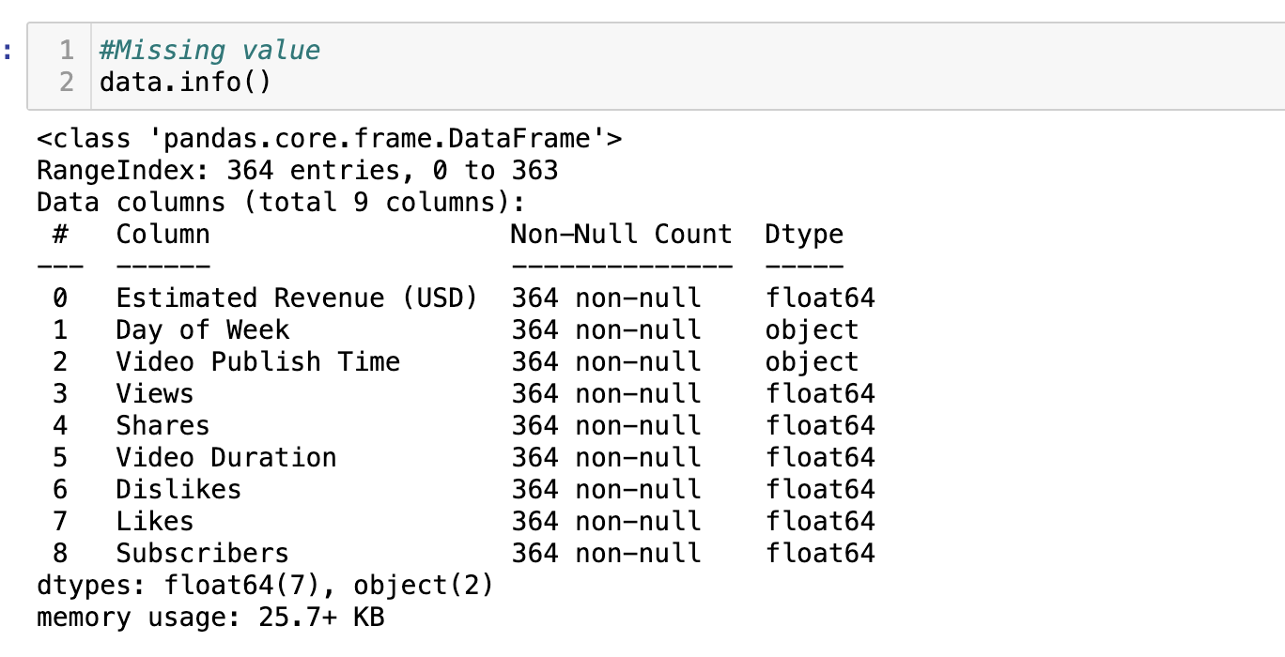
Data Cleaning

Slide 45
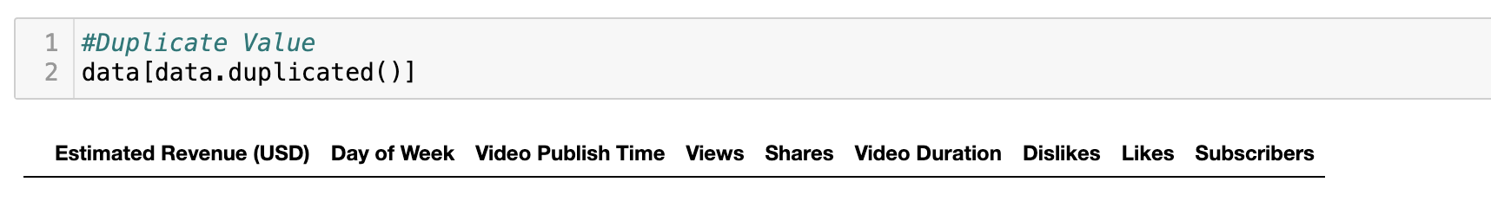
Data Cleaning

Slide 46
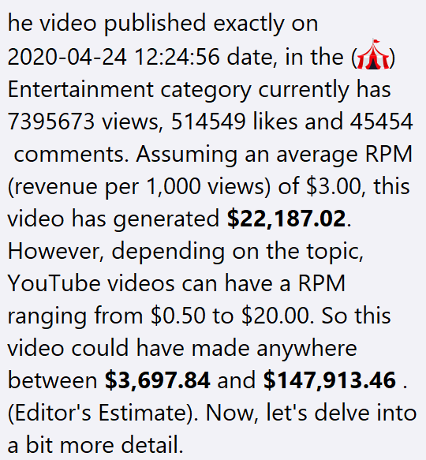
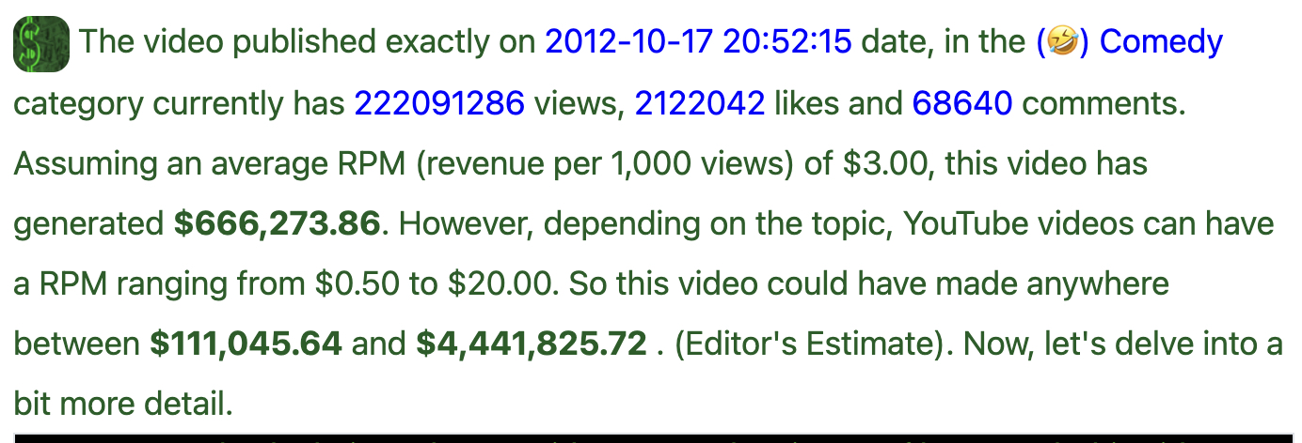
Game Time
Key and Peele
Ryan Higa

